Slide 1
Exploring the Potential of Machine Learning in Insurance Claims
Dataset: UK Traffic Accidents

Slide 2
Contents
Introduction
Data Cleaning
Data Visualization
Model Construction
Implication & Improvement

Slide 3
INTRODUCTION

Slide 4
Data Set：UK Traffic Accident 2005
Goal: Help Insurance Company To
Evaluate insurance claims payment
Evaluate underwriting of insurance plan
Insurance claim fraud prediction/investigation
Three Target Accident Severity
Slight
Serious
Fatal
Multi-Classification Problem

Slide 5
DATA CLEANING

Slide 6
First...
Replace Errant/Misspelled Values
Drop Blank Rows with Blank Values
Format Date in Dateline format and add Column for Month and Hour

Slide 7
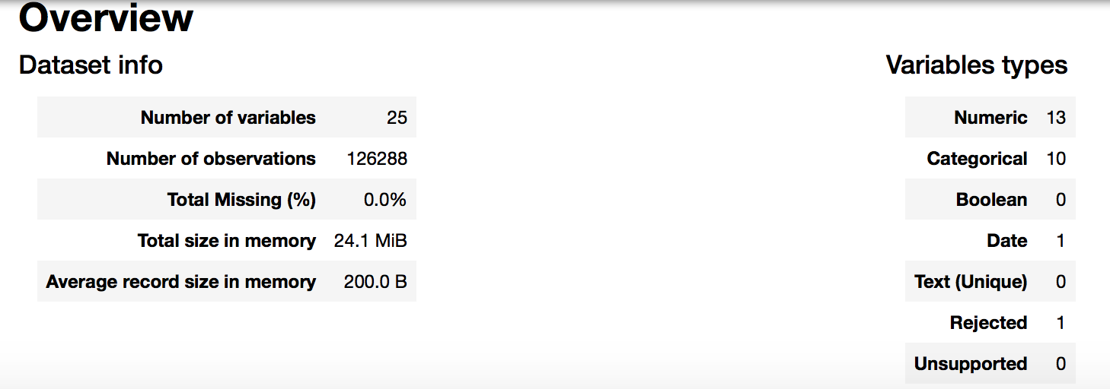
Overview of UK Accidents Dataset
88% of the data belongs to slight and 11% to serious and 1% to fatal
71.6% of accident occur in Urban while 28.4 % occur in Rural
A lot of the data are skewed to one variable

Slide 8
Metadata Information
- Accident Index: index identifier of accidents
- Longitude: longitude coordinates of accident
- Latitude: latitude coordinates of accident
- Accident Severity: the severity of accident
- Carriageway Hazard: none/ other object on road/ any animal in carriageway/ pedestrian in carriage/ previous accident/ vehicle load on road
- Date: the date that accident that occurred in the format DD/MM/YYYY
- Did Police officer attend scene of accident? (1- No, 2- Yes, 3- Yes with Ambulance)
- Junction Control: Was there junction control at the location of accident
- Light Conditions: the light condition of accident
- Number of Casualties
- Number of Vehicles
- Pedestrian crossing-human control
- Pedestrian crossing physical facilities
- Road Surface Conditions
- Road Type
- Special Conditions at site
- Speed limit
- Urban or Rural Area
- Weather Conditions

Slide 9
DATA VISUALIZATION

Slide 10
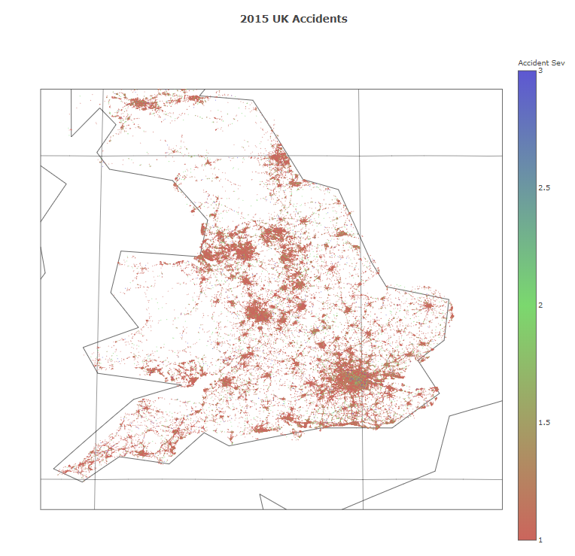
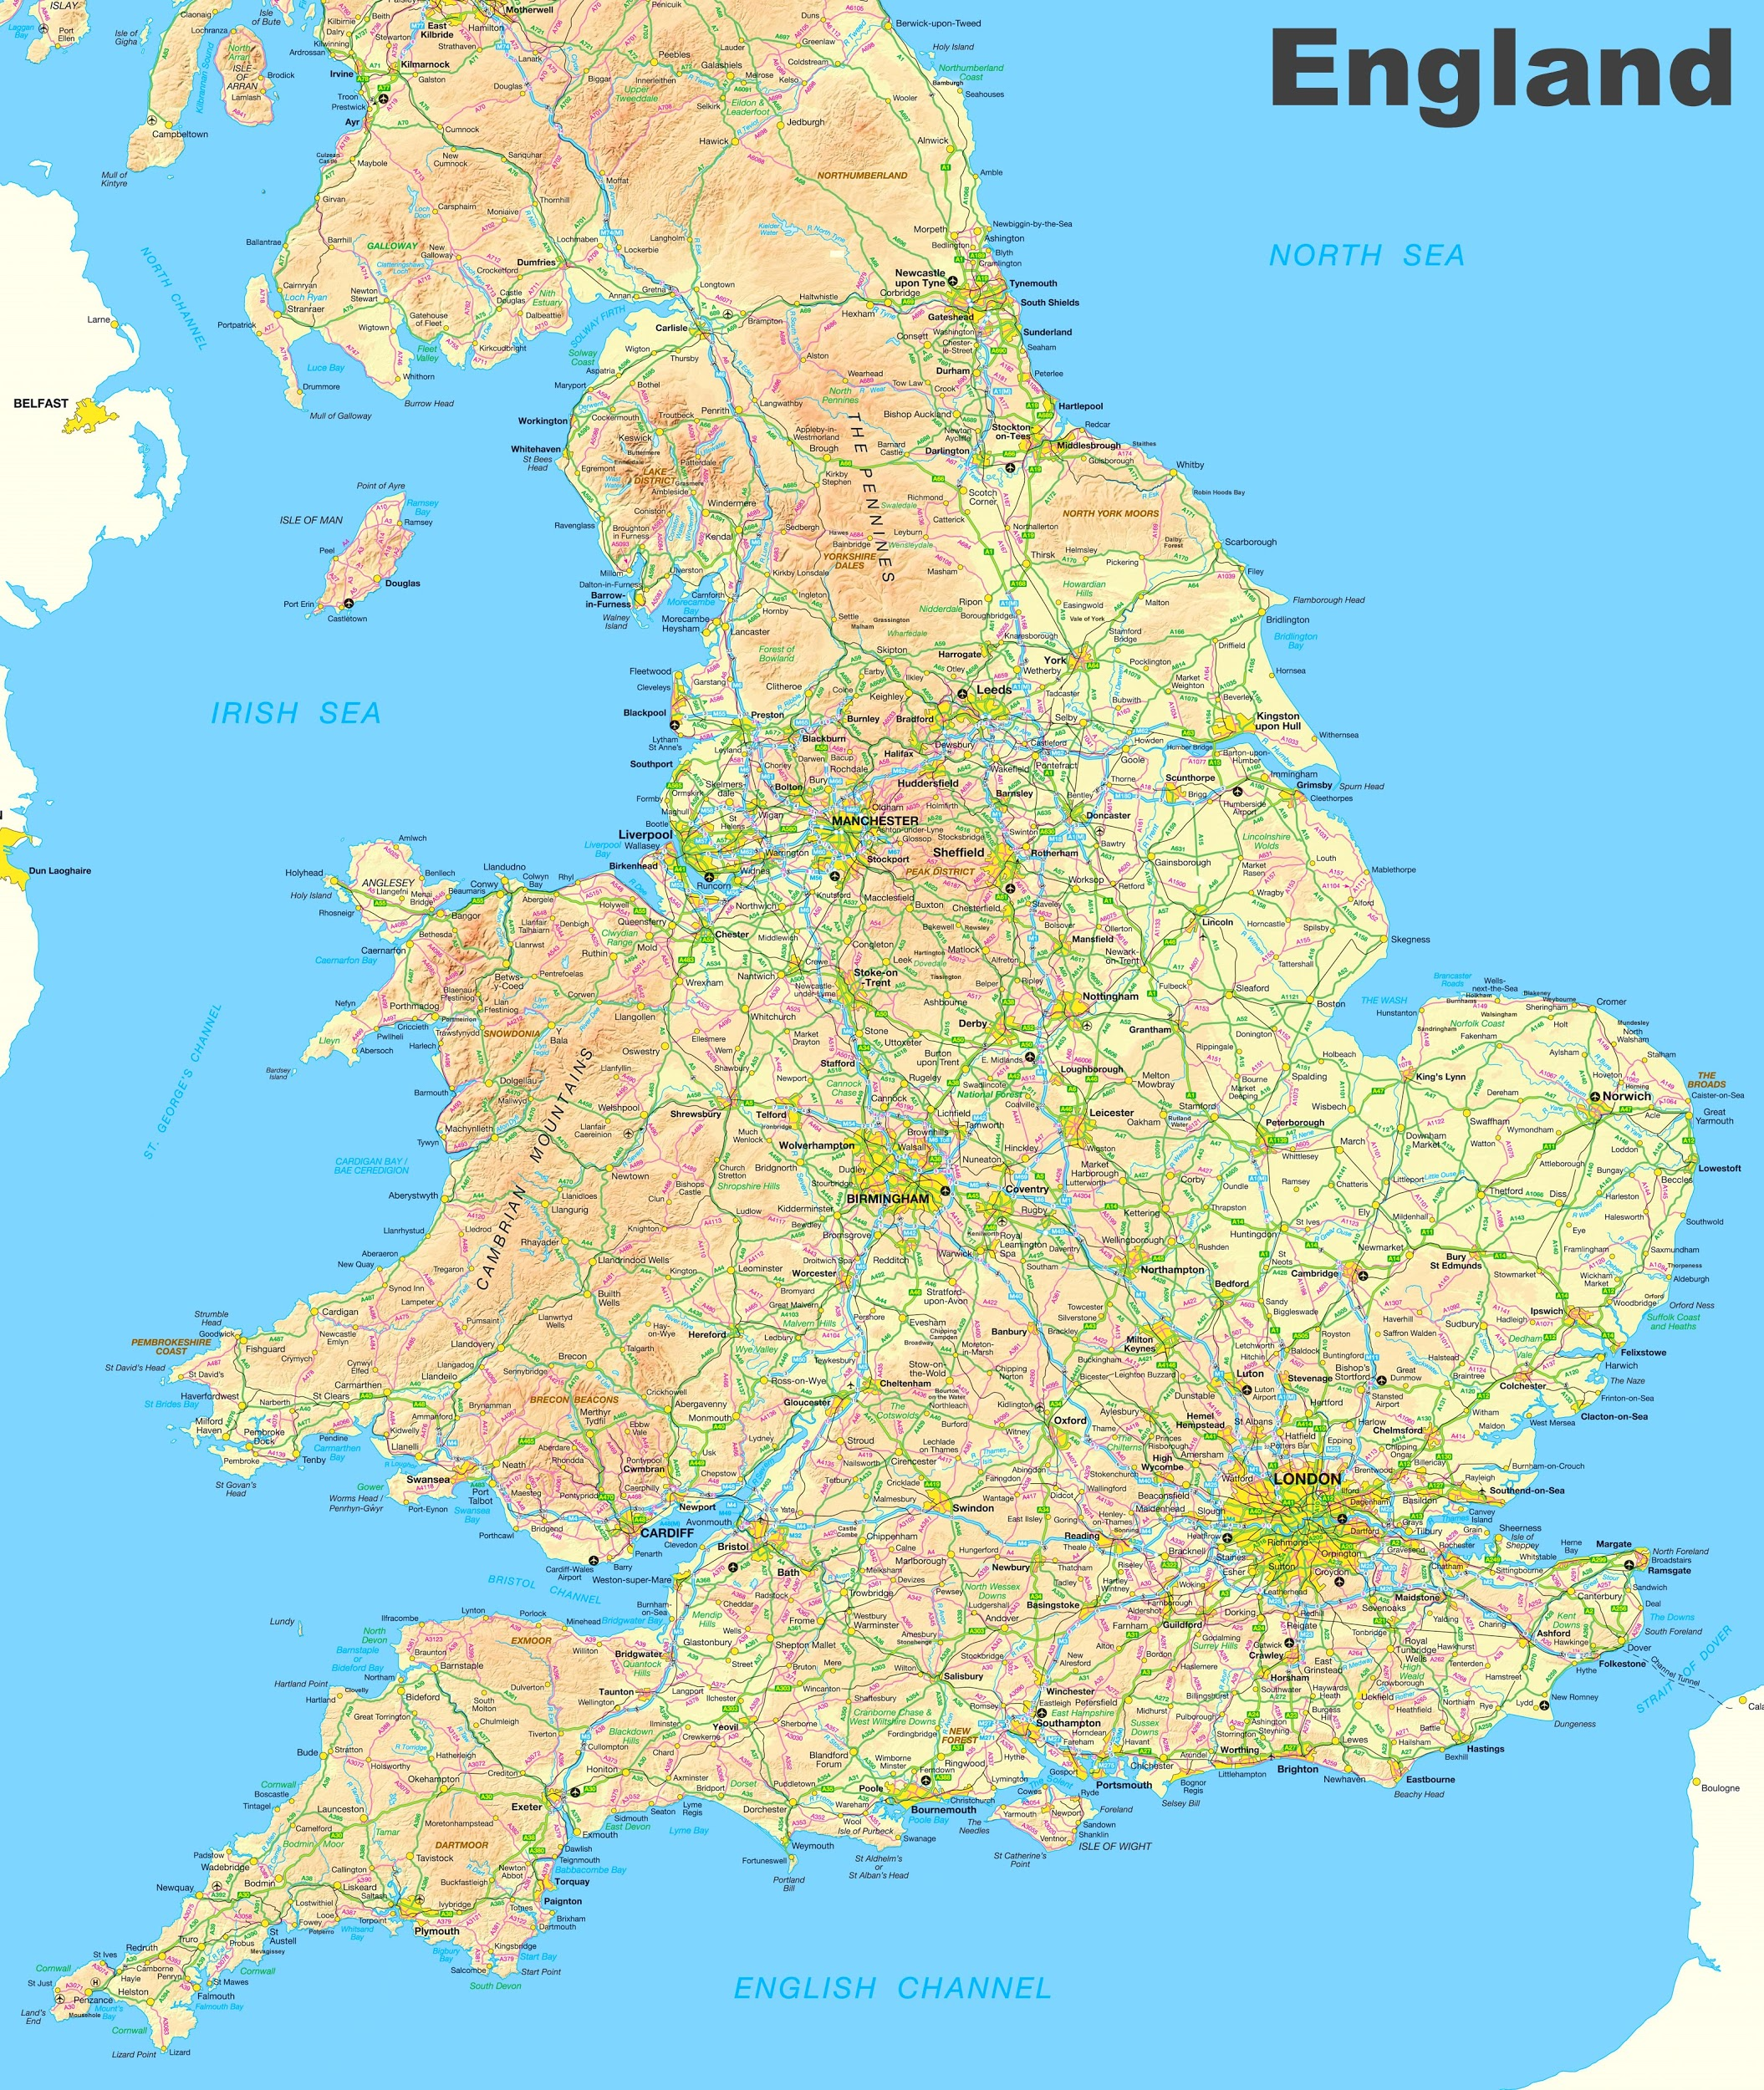
Map
Notes:
Overlaying the geo-coordinates of accidents with the map, we are able to create a visualization of the location of the accidents. We are able to observe some clustering of accidents in major cities, and that there seems to be more severity of accidents that occur in rural but hard to tell just from map.
It is interesting to note that there seems to be some accidents that occur in the sea, this may be due to rounding of the geo-location data or mapping data not 100% accurate. But maybe also some accidents occured where the car drove off into the sea, and that why marked as occured not on land.

Slide 11
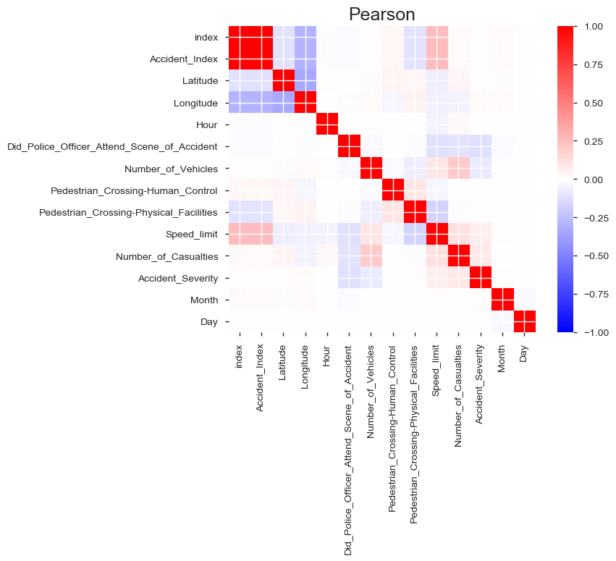
Correlation matrix
Strong Negative Correlation:
Pedestrian crossing physical facilities
Strong Positive Correlation:
Speed limit
Pedestrian crossing human control

Slide 12
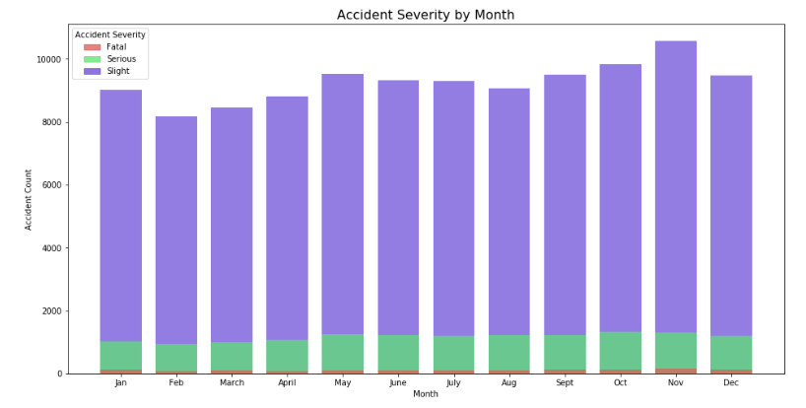
Month
Notes:
We can observe that winter period shows a higher number of accidents which make sense as snow and reduced visibility can cause accidents to occur more frequently. Though from the graph, it seems that accident severity seems to be quite evenly distributed across the month.

Slide 13
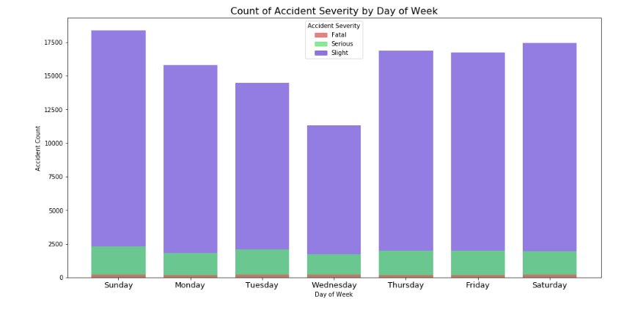
Day of Week

Slide 14
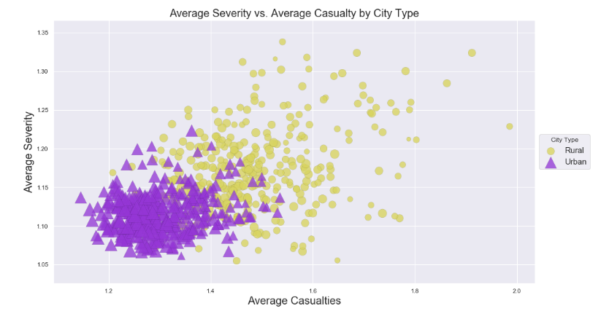
Rural Vs Urban
Notes:
As from the below scatter plot, we are able to see that on Urban cluster tend to have a lower average severity and lower number of casualities. While on the other hand rural area tend to have a more seperated cluster, where we see an increasing trend of severity and casualities!

Slide 15
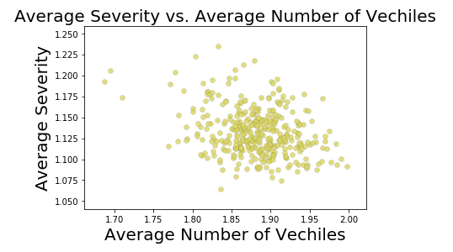
Number of Vech

Slide 16
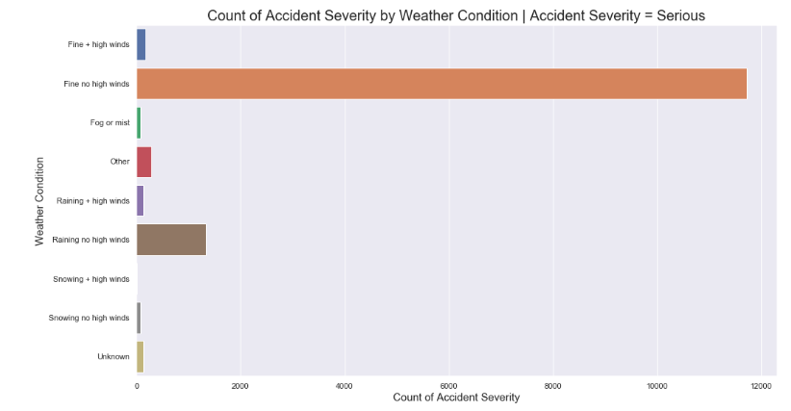
Highly Cardinality Categorical Variable
How Come?

Slide 17
Model Building

Slide 18
Data Preparation
Remove no contextual variables
Longitude, Latitude, Date
Sklearn data formatting
Converting categorical variable to dummy variable
Holdout Validation (90% training to 10% testing)
Confusion Matrix
Highly Skewed Dataset
SMOTE (Synthetic Minority Over Sampling Technique)

Slide 19
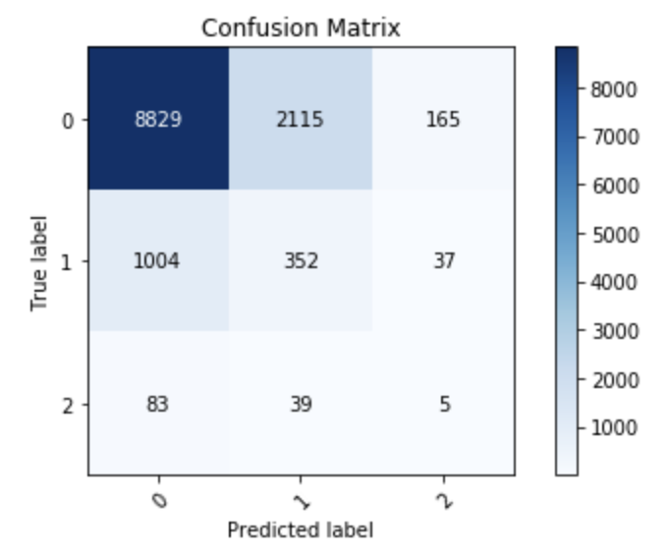
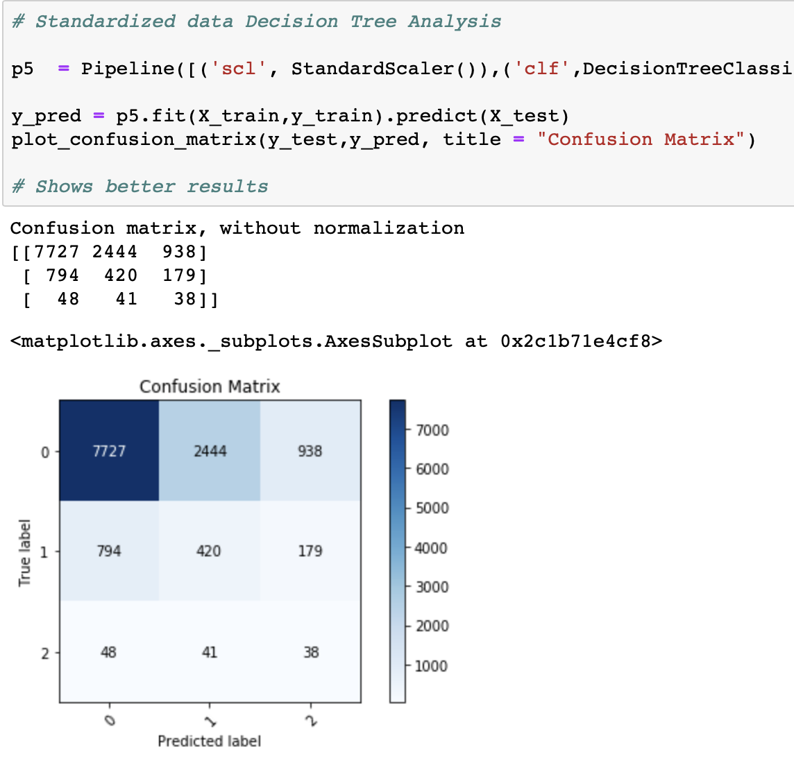
Initial building
Decision Tree 1
Decision Tree 2 (Standardized)
Score: 0.88
Score: 0.87

Slide 20
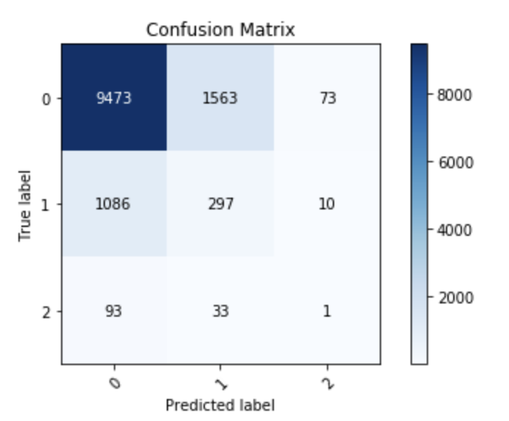
Random Forest Model
Score: 0.90

Slide 21
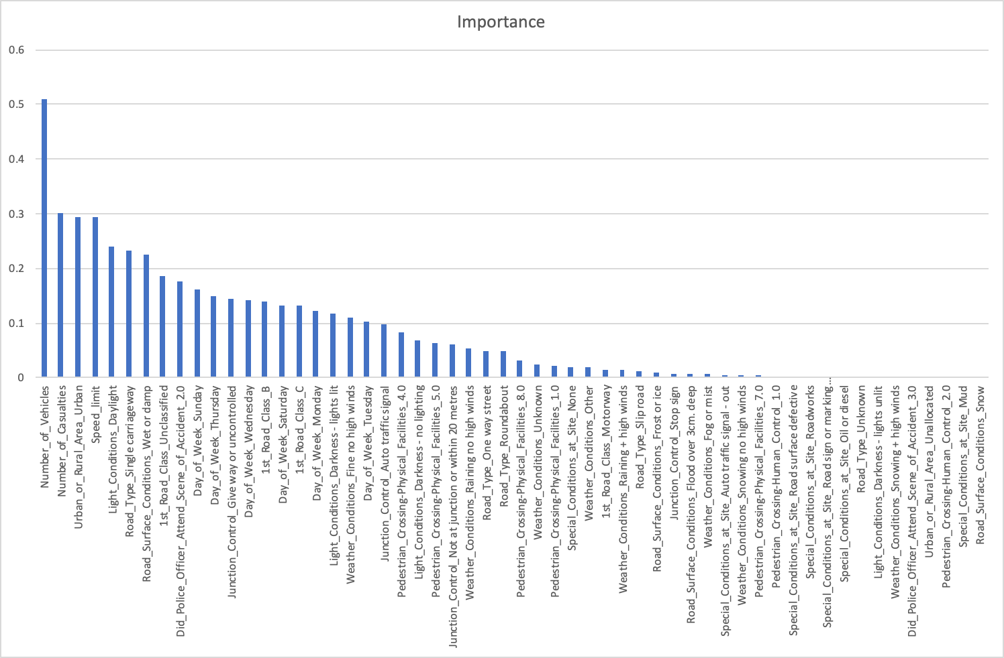
Permutation Variable Importance
As the standard SKLearn variable importance has the tendency to inflate the importance of continuous feature and highly cardinal categorical variable which our dataset suffer.
Permutation Variable Importance
Measure feature importance by observing how random re-shuffling of each predictor influence model performance.

Slide 22
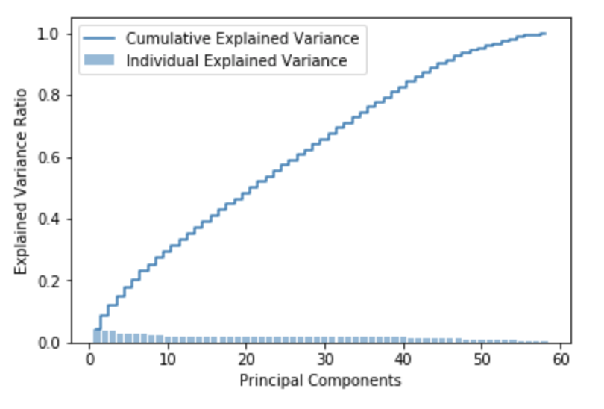
PCA
not useful to conduct dimension reduction

Slide 23
Machine Learning Algorithm tested
Algorithm | Scores (2.s.f) | Keep
OvA(Perceptron) | 0.82 | ✔
OvA(Logistic Regression) | 0.87 | ✔
Neural Net | 0.88 | ✔
Nearest Neighbor | 0.86 | ✔
Naive Bayes | 0.10 | ⨯
Linear SVM | N/A | ⨯
RBF SVM | N/A | ⨯
Notes:
Other than Perceptron and logistic regression all other algos tested are inherently multi-class thus we do need to conduct changes to them, but for perceptron and logit we would have to apply a one vs all classification to make useable for multi-classification problem

Slide 24
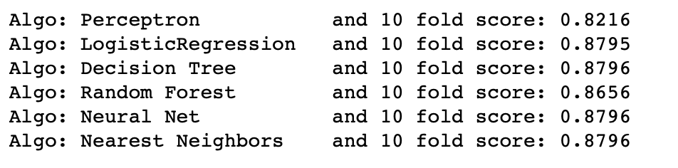
Hyperparameter tuning using GridSearch

Slide 25
Evaluation + Ensemble Model

Slide 26
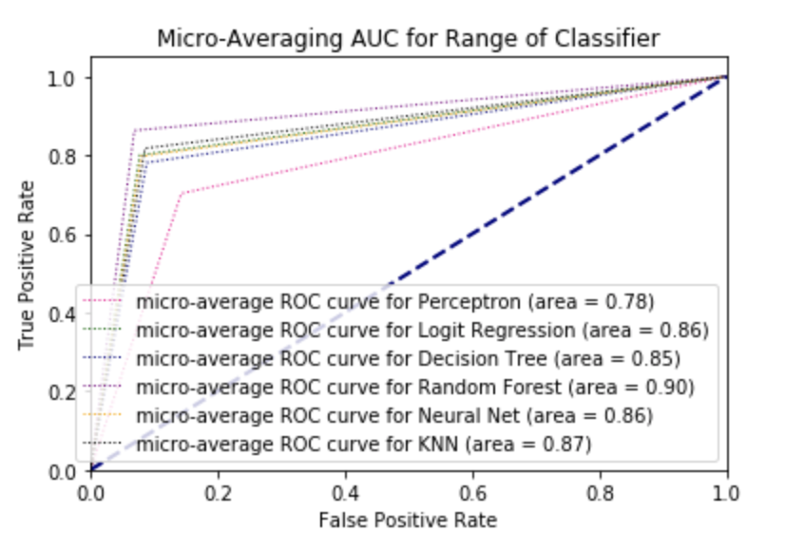
ROC Curve - Micro Averaging
Notes:
Since we are dealing with a multi-class problem… well the problem is what is the sensitivity and 1-specificity number as we have multiple -> thus since we have 3 class it is possible to visualize it 3D, but if extension to more classes then it will be better to conduct micro-averaging

Slide 27
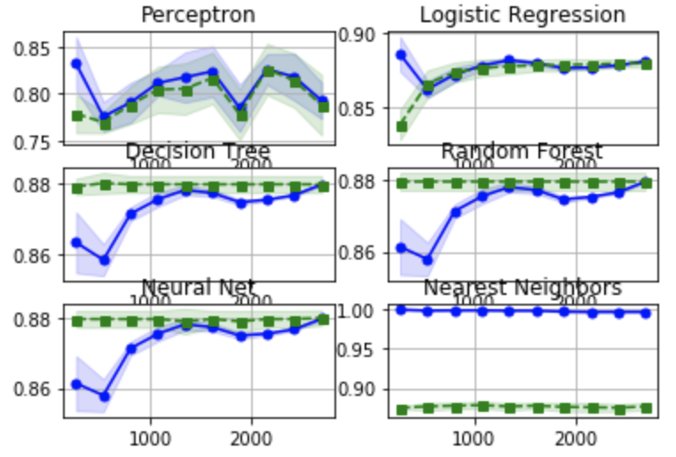
Learning Curve
Overfitting Model
Nearest Neighbors
Underfitting Model
Perceptron
Just Right
Logistic Regression
Decision Tree
Random Forest
Neural Net
Notes:
Suppose to add more data or reduce model complexity for overfitting model, or we should increase model complexity for underfitting model. But due to limited data available, it was not very possible for us to further modify the model.

Slide 28
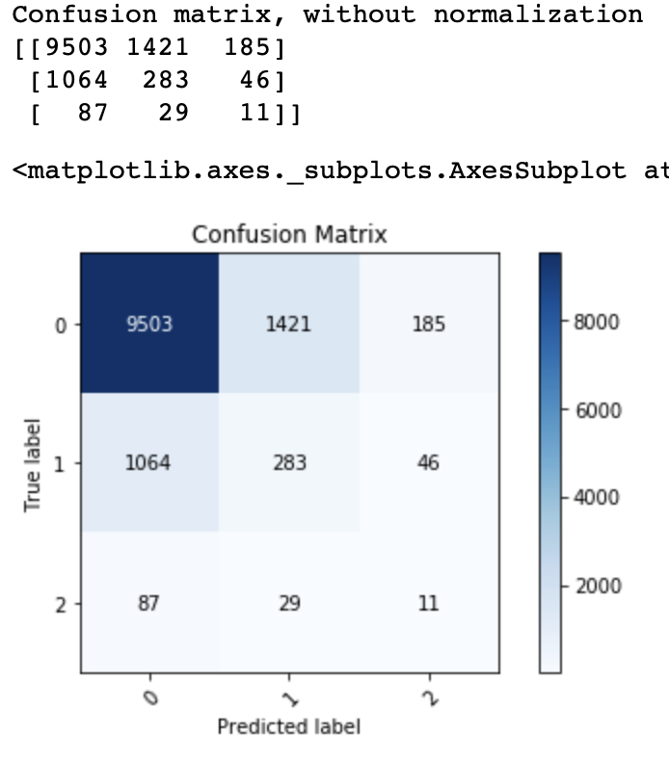
Ensemble Model
Majority Voting Model
Results 88% accuracy

Slide 29
Model recommendation
Ensemble model for Slight and Decision Tree for Serious/fatal prediction
Will talk more about this in the improvement section
Ensemble Model
Decision Tree (Standardized)

Slide 30
IMPLICATION & IMPROVEMENT

Slide 31
Implication
Compensation Decision
Insurance claim — Model: Predict accident severity — Help decide the amount/rate of the compensation
Fraud Claim
Insurance claim — Model: check whether exaggerated in filing—Fraud investigation

Slide 32
Improvement
To build a model with weighting of information (+ class weights to help with the skewed data problem)
The model may have difficulty classifying serious accidents due to highly skewed dataset
The model requires all completed data, while in reality this is often not the case
Choose our datasets over a longer time span
Accident prone zone and cause of fatal accidents may change over time

Slide 33
Thank You
Q&A

